Slide 1
design issues for the layers
A number of design issues exist for the layer to layer approach of computer networks. Some of the main design issues are as follows −
Reliability
Network channels and components may be unreliable, resulting in loss of bits while data transfer. So, an important design issue is to make sure that the information transferred is not distorted.
Scalability
Networks are continuously evolving. The sizes are continually increasing leading to congestion. Also, when new technologies are applied to the added components, it may lead to incompatibility issues. Hence, the design should be done so that the networks are scalable and can accommodate such additions and alterations.

Slide 2
Addressing
At a particular time, innumerable messages are being transferred between large numbers of computers. So, a naming or addressing system should exist so that each layer can identify the sender and receivers of each message.
Error Control
Unreliable channels introduce a number of errors in the data streams that are communicated. So, the layers need to agree upon common error detection and error correction methods so as to protect data packets while they are transferred.

Slide 3
Flow Control
If the rate at which data is produced by the sender is higher than the rate at which data is received by the receiver, there are chances of overflowing the receiver. So, a proper flow control mechanism needs to be implemented.
Resource Allocation
Computer networks provide services in the form of network resources to the end users. The main design issue is to allocate and de-allocate resources to processes. The allocation/de-allocation should occur so that minimal interference among the hosts occurs and there is optimal usage of the resources.

Slide 4
Statistical Multiplexing
It is not feasible to allocate a dedicated path for each message while it is being transferred from the source to the destination. So, the data channel needs to be multiplexed, so as to allocate a fraction of the bandwidth or time to each host.
Routing
There may be multiple paths from the source to the destination. Routing involves choosing an optimal path among all possible paths, in terms of cost and time. There are several routing algorithms that are used in network systems.
Security
A major factor of data communication is to defend it against threats like eavesdropping and surreptitious alteration of messages. So, there should be adequate mechanisms to prevent unauthorized access to data through authentication and cryptography.

Slide 5
Protocol Hierarchies in Computer Network
A protocol is simply defined as a set of rules and regulations for data communication. Rules are basically defined for each and every step and process at time of communication among two or more computers. Networks are needed to follow these protocols to transmit data successfully. All protocols might be implemented using hardware, software, or combination of both of them. There are three aspects of protocols given below :
Syntax – It is used to explain data format that is needed to be sent or received.
Semantics – It is used to explain exact meaning of each of sections of bits that are usually transferred.
Timings – It is used to explain exact time at which data is generally transferred along with speed at which it is transferred.
Protocol Hierarchies : Generally, Computer networks are comprised of or contain a large number of pieces of hardware and software. To just simplify network design, various networks are organized and arranged as a stack of layers of hardware and software, one on top of another. The number, name, content, and function of each layer might vary and can be different from one network to another. The main purpose of each of layers is just to offer and provide services to higher layers that are present. Each and every layer has some particular task or function. In programming, this concept is very common. The networks are organized and arranged as different layers or levels simply to reduce and minimize complexity of design of network software.

Slide 6
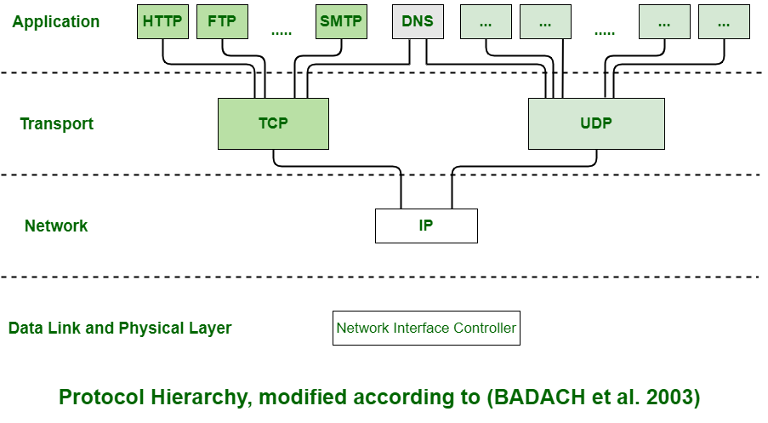

Slide 7
Example : Below is diagram representing a five-layer network. The diagram shows communication between Host 1 and Host 2. The data stream is passed through a number of layers from one host to other. Virtual communication is represented using dotted lines between peer layers. Physical communication is represented using solid arrows between adjacent layers. Through physical medium, actual communication occurs. The layers at same level are commonly known as peers. The peer basically has a set of communication protocols. An interface is present between each of layers that are used to explain services provided by lower layer to higher layer.
Advantages :
The layers generally reduce complexity of communication between networks
It increases network lifetime.
It also uses energy efficiently.
It does not require overall knowledge and understanding of network.

Slide 8
